Slide 1

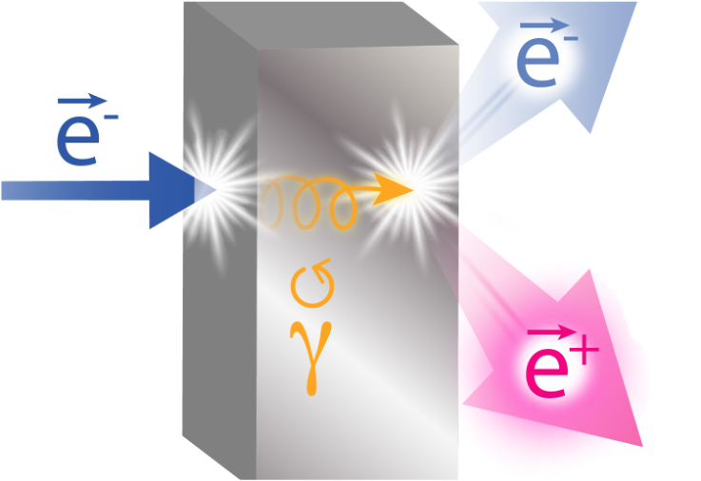
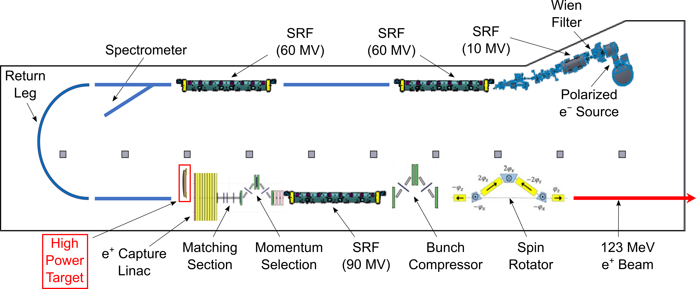
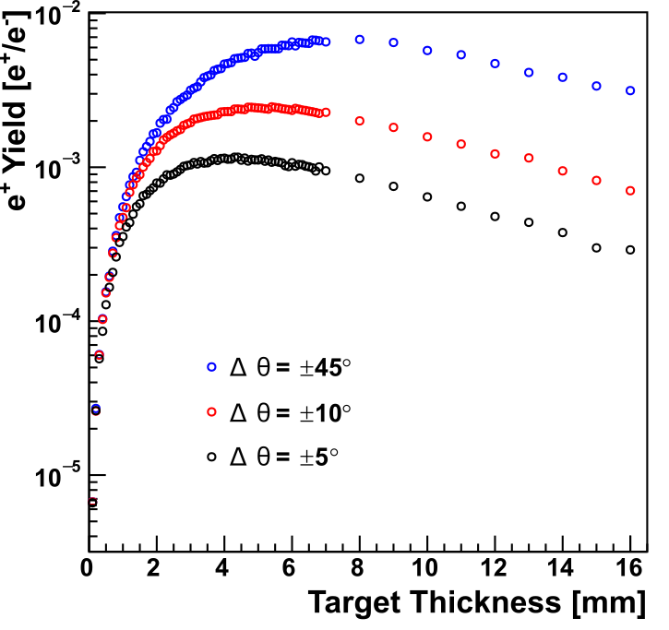
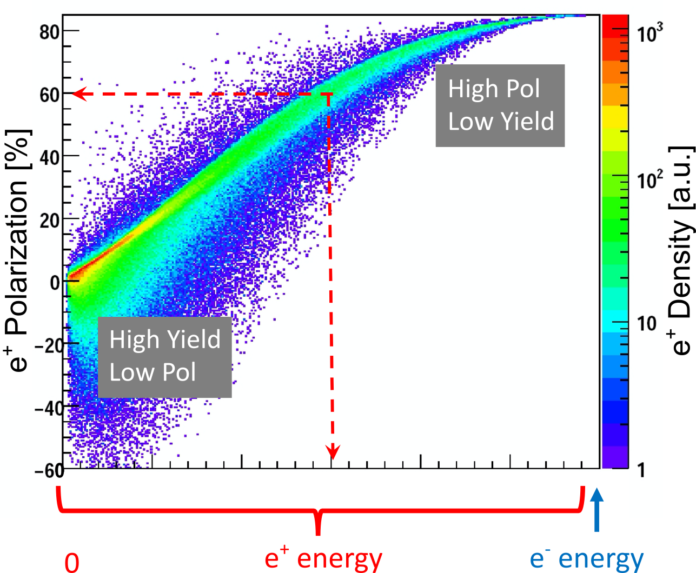
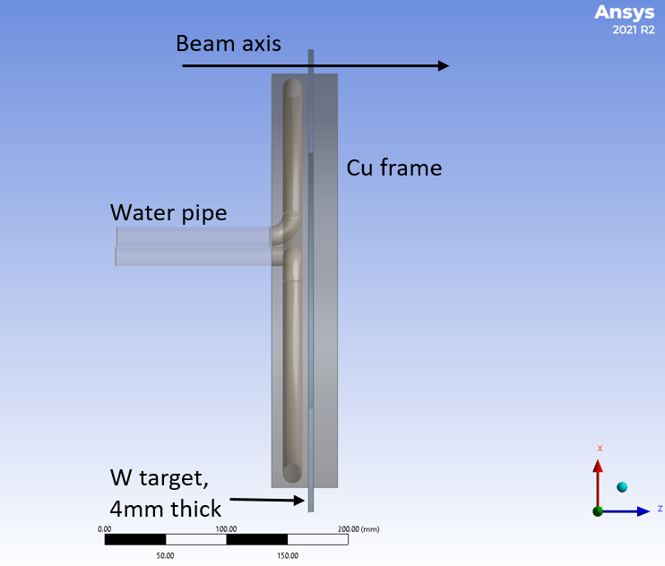
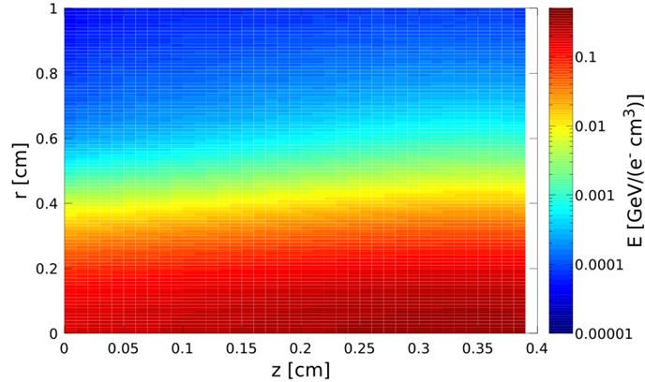
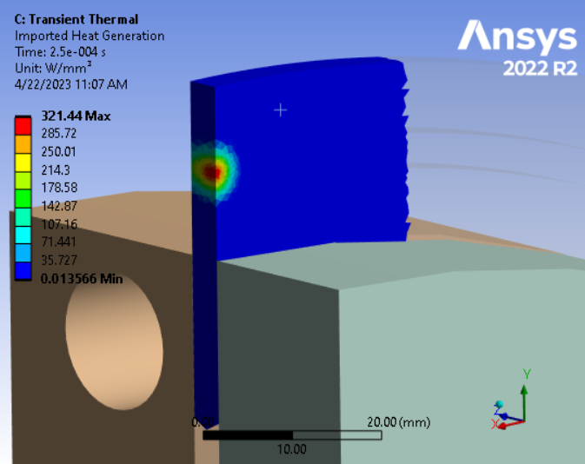
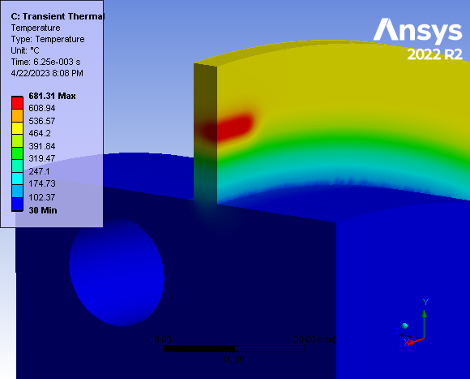
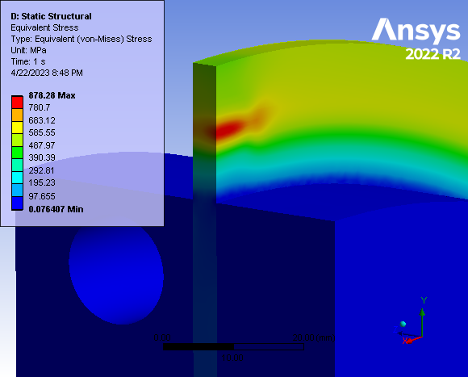


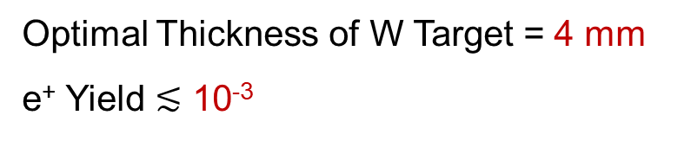
Evaluation of a High-Power Target Design for Positron Production at CEBAF
A. Ushakov^{1,2}, S. Covrig², J. Grames², S. Habet^{1,2}, C. Le Galliard¹, E. Voutier¹
¹Université Paris-Saclay, CNRS/IN2P3/IJCLab, 91405 Orsay, France
²Thomas Jefferson National Accelerator Facility, Newport News, VA 23606, USA
Abstract: A source for polarized positron beams at the Continuous Electron Beam Accelerator Facility (CEBAF) at Jefferson Lab is being designed. The Polarized Electrons for Polarized Positrons (PEPPo) concept is used to produce polarized e⁺e⁻-pairs from the bremsstrahlung radiation of a longitudinally polarized electron beam interacting within a high-Z conversion target. The scheme under consideration includes a 4 mm thick tungsten target that absorbs 17 kW deposited by a 1 mA continuous-wave electron beam with an energy of 120 MeV. The concept of a rotating tungsten rim mounted on a water-cooled copper disk was explored. The results of ANSYS thermal and mechanical analyses are discussed together with FLUKA evaluations of the radiation damages.
Scheme of e⁺ Source
Yield vs Target Thickness
e⁺ Polarization vs Energy
Δp_{e+}/p_{e+} = ±0.05
Tungsten
For 120 MeV e‒ and max Figure-of-Merit (FoM = $YP^{2}$):
Optimal Thickness of W Target = 4 mm
e⁺ Yield $≲$ 10⁻³
For max FoM:
Optimal energy of positrons at exit side of target is about half of electron beam energy
Positron polarization is 60%
Concept of Rotated Water-Cooled Target
e‒ Beam (1 mA)
Power Deposition in
Target (17 kW)
17 kW heat deposition in 4 mm thick tungsten
Energy Deposition in W Target (FLUKA)
Heat Power Density
120 MeV e‒ beam
Max E_{dep} = 0.321 GeV/(e‒ cm³)
Rotated W target mounted on water-cooled Cu disk
1.5 mm RMS spot size
Beam passes W-target at radius of 18 cm
2 Hz rot. frequency
0.3 kg/s water mass flow (1.5 m/s)
For 1 mA e‒ beam:
P_{max} = 321 W/mm³
Temperature vs Time
Distribution of Temperature
Distribution of Equivalent von-Mises Stress
T_{max} = 681 °C
e‒ beam with RMS size of 1.5 mm
moving with 2.3 m/s
ΔT = 188 °C
T_{max} = 681 °C in tungsten
σ_{vM max} = 878 MPa
Radiation Damage (FLUKA)
Summary and Outlook
A high-power target for positron production at the future Ce⁺BAF positron injector [1] was evaluated. Time-dependent CFD simulations (ANSYS Fluent) were implemented. The temperature, mechanical stress and radiation damage were calculated for the tungsten target with a thickness of 4 mm and 17 kW power deposited by 1 mA CW electron beam with an energy of 120 MeV. The peak temperature of the target rotated with a velocity of 2.3 m/s is 680°C and the maximal equivalent von Mises stress is 880 MPa. The estimated annual radiation damage is 0.21 dpa. To check if the target can be used safely over an extended period under such conditions and find experimentally the endurance stress limits and the impact of radiation damage on the material properties, tests of the target materials (tungsten and tantalum) using 50 µA at 3.5 MeV electron beam at Mainz Microtron (MAMI) have been started. Material fatigue tests using a high-power laser are also planned, which will be similar to performed tungsten foil tests for the APEX target at Jefferson Lab [2].
[1] J. Grames et al., “Positron beams at Ce⁺BAF,” presented at IPAC’23, Venice, Italy, May 2023, paper MOPL152, this conference.
[2] S. Gopinath and S. Covrig, “Hall A – APEX target thermal assessment,” Jefferson Lab, Tech. Rep. PMAG0000-0001-A0001, 2020.
Annual maximal radiation damage in tungsten at R = 18 cm:
0.21 dpa
Radiation damage tests are ongoing.
This work is supported by the European Union’s Horizon 2020 Research and Innovation program under Grant Agreement No 824093 and the U.S. DOE, Office of Science, Office of Nuclear Physics, contract DE-AC05-06OR23177.

